Slide 1
Department of MCA
Advanced Programming -22MCA303
Handling By
Nirupama K
Asst. Prof. Dept. of MCA

Slide 2
Advanced Programming -22MCA303
Module 1 | Getting started with .NET Framework 4.0 and C#

Slide 3
What is .NET ?
Microsoft.NET is a Framework
Microsoft .NET is a Framework which provides a common platform to Execute or, Run the applications developed in various programming languages.
The main intention was to bridge the gap in interoperability between services of various programming languages.

Slide 4
Introduction
.Net framework is an essential component of window operating system
Programming languages C#, J#, VB and Visual C++
3 important components CRL, CLS, CTS
.Net framework is a bridge between applications which are created using C#, Visual Basic
Evolution
Mid 90s java was popular to develop the application
2002 J2EE introduced
February 10 2002 .Net framework 1.0 released along with visual studio IDE
Advanced Programming -22MCA303
khande@358

Slide 5
.NET Framework Objectives
The .NET Framework is designed to fulfill the following objectives:
Provide object-oriented programming environment
Provide environment for developing various types of applications, such as Windows-based applications and Web-based applications
To ensure that code based on the .NET Framework can integrate with any other code
Notes:
Faculty Notes:

Slide 6
Benefits of .NET Framework
Consistent Programming Model- Provides a consistent object-oriented programming model across different languages.
Cross-platform support- specifies that any window platform that support CLR can execute .NET application, that is, .NET application enables interpretability between multiple windows operating system.
Language Interpretability- Enable code written in different language to interact with each other .
Automatic Management of Resources- Specifies that in .NET you do not need to manually free the application resources, such as files, memory, network and database connection.
Ease of deployment - specifies that the .NET framework install applications or components that do not effect the existing application

Slide 7
. NET Framework
VB
C++
C#
JScript
…
Visual Studio 2008
Common Language Specification
ASP.NET
Windows Forms
ADO.NET
Base Class Library
(CLR) Common Language Runtime
Operating System
Notes:
Faculty Notes:
Figure above illustrates the Microsoft .NET Framework. All .NET languages are built on a Common Language Specification. While designed specifically to support the .NET versions of Visual Basic, C++, C# and JScript, .NET also supports other languages that can be modified to this specification. These include Perl, Python, COBOL, Eiffel, Pascal, Fortran, SmallTalk, Java, RPG, Ada, APL, J# and others.
The .NET Framework is designed to unify programming models to enable cross-language integration.
The Microsoft Active Server Page (ASP) technology has been enhanced as ASP.NET and is designed to allow the easy development of Web services and Web forms see figure above. The development of Windows forms has also been improved with .NET, and ADO.NET provides full support for data and XML. Visual Studio 2005 supports and integrates all of these development environments, automating many development tasks that previously required manual integration.
Each of the languages in the figure is supported by Visual Studio 2005, which is an enhanced IDE. The other languages discussed earlier can also be added to Visual Studio 2005. The strategy behind Visual Studio 2005 is to enable applications to be developed within Windows for later execution in a .NET environment on any platform.

Slide 8
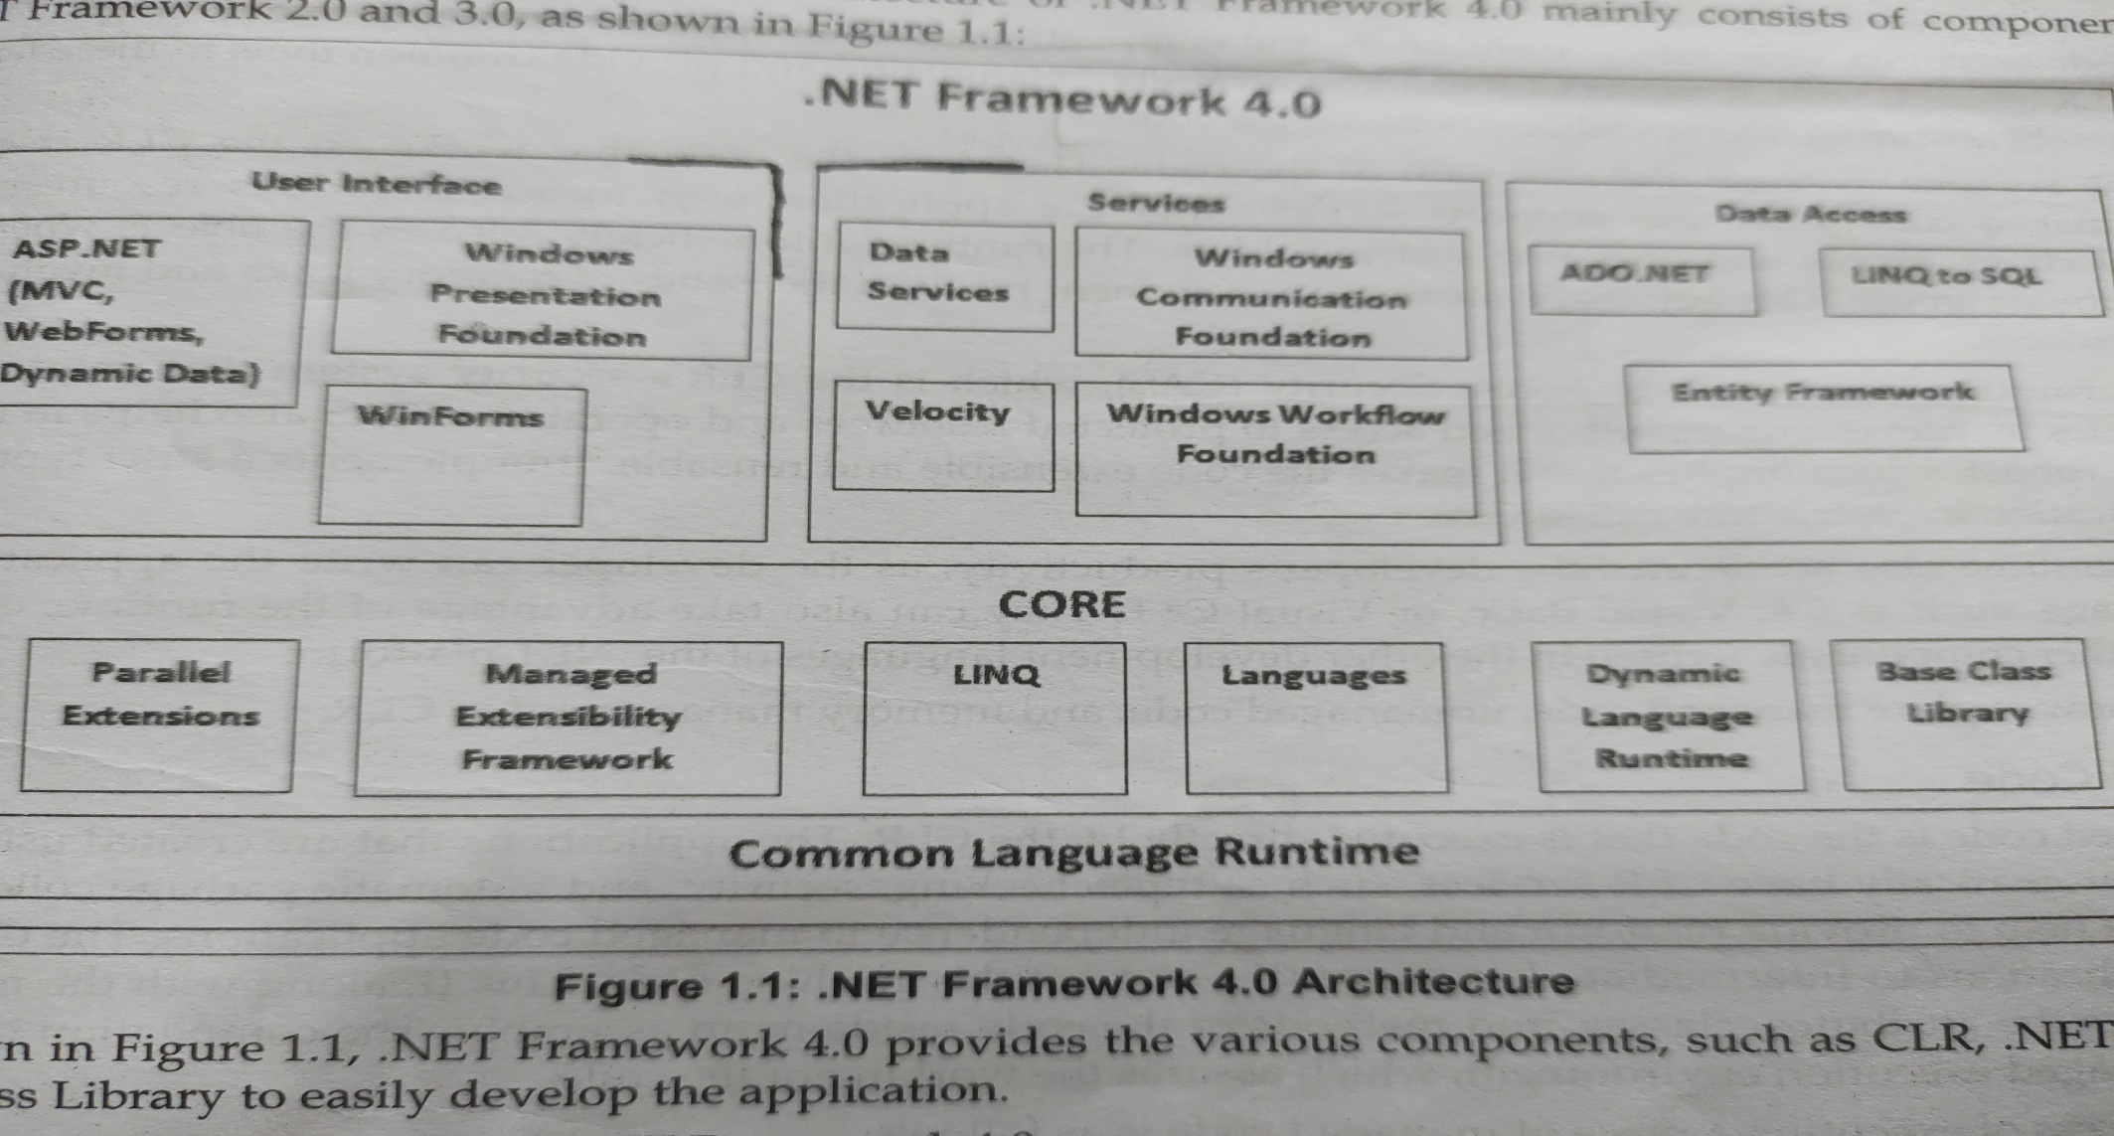
. NET Framework architecture

Slide 9
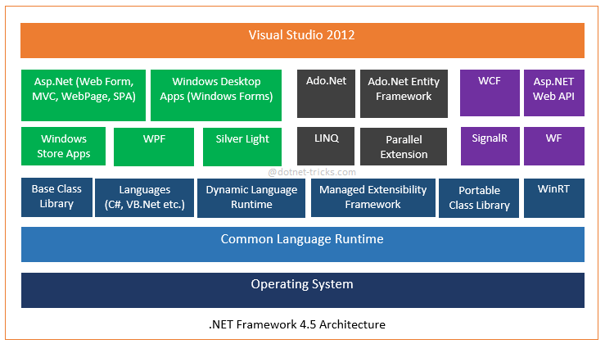

Slide 10
The Components of .NET Framework :
Common Language Runtime (CLR)
Most important component of .Net framework
Memory management, exception handling, debugging, security, thread execution
Managed code- executes directly by the CLR- selecting language compiler, compiling the code to IL, compiling IL to native mode, execute the code
CLR also support for various resources such as collections, arrays, operating system folder
Runtime automatically releases the object when they are no longer in use
Unmanaged code
Common type specification (CTS)
CTS specifies certain guidelines for declaring, using and managing types at runtime
Helps in cross language specification
.
Notes:
Faculty Notes:
Just read out the slide the sub point are explained in next slide

Slide 11
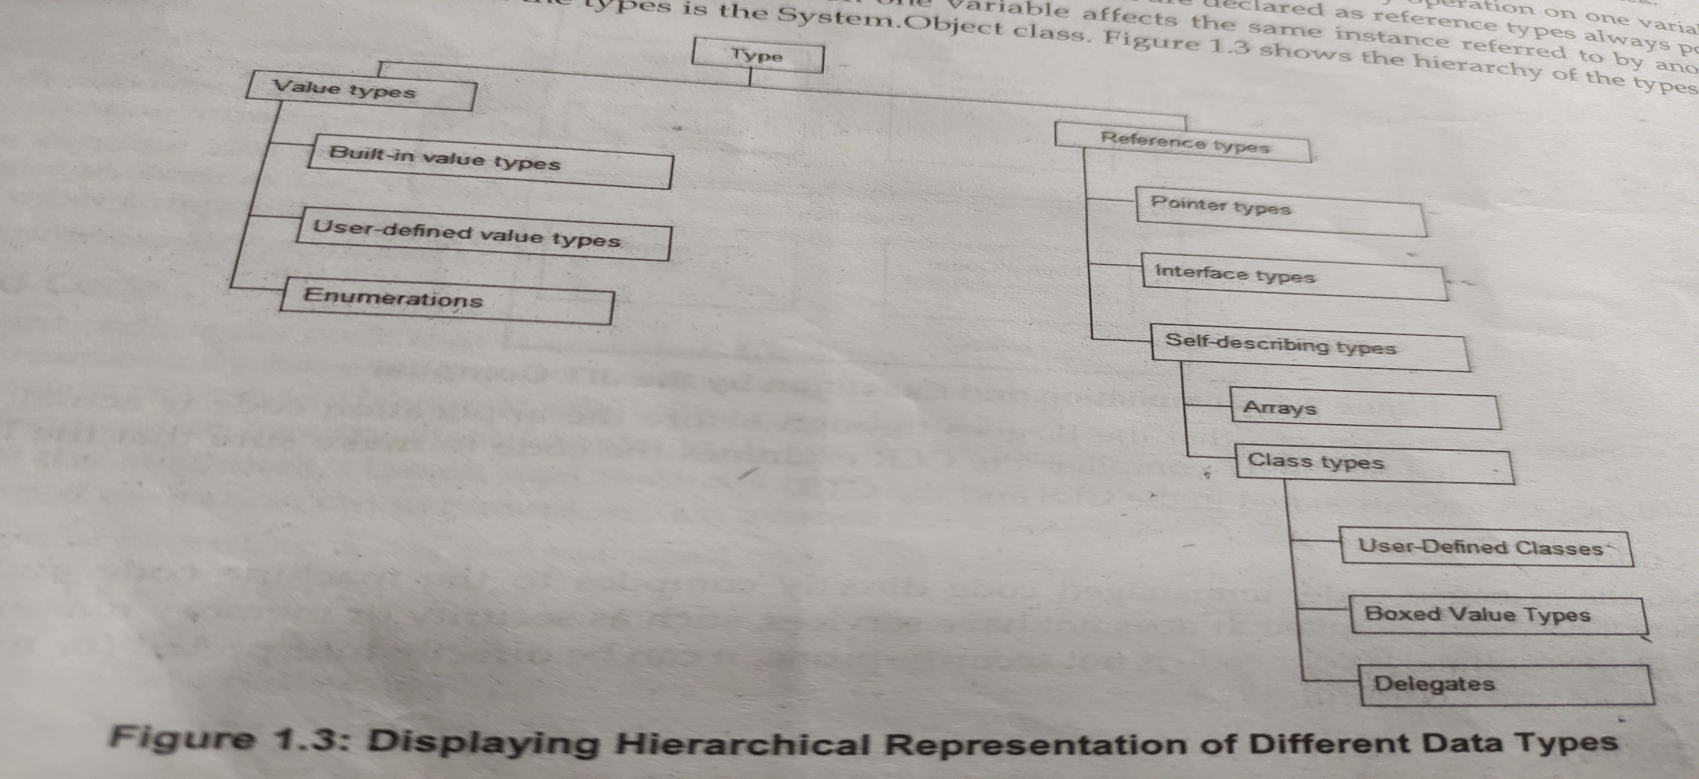
CTS
Support Object oriented model for implementation of different programming languages
Support primitive data types

Slide 12
Common Language Specification
CLS performs the following functions:
Establishes a framework that helps enable cross-language integration, type safety, and high performance code execution
Provides an object-oriented model that supports the complete implementation of many programming languages
Defines rules that languages must follow, which helps ensure that objects written in different languages can interact with each other

Slide 13
Other components of framework
Metadata and Assemblies
.NET framework class library
Windows forms
ASP .NET and ASP .NET AJAX
ADO .NET- disconnected architecture, cached data in dataset, scalability and transfer of data in XML format
Window Workflow Foundation
Window Presentation Foundation
Window Communication Foundation
Windows CardSpace
LINQ

Slide 14
Execution in CLR
Source code
VB
C#
C++
Compiler
Compiler
Compiler
Managed
code
Assembly
IL Code
Assembly
IL Code
Assembly
IL Code
Common Language Runtime
JIT Compiler
Native Code
Operating System Services
Notes:
Faculty Notes:
We already know that an assembly does NOT contain native binary code, but instead MSIL code. Obviously before the MSIL code can be executed it must be converted into native binary instructions. Converted? Does this mean interpreted? NO! The MSIL code is compiled and not thrown away. This means that the next time the code is requested it is already in the form of machine instructions and thus this mechanism in the log run is far more efficient than an interpreter for example.
The compilation is carried out by a JIT (Just In Time) compiler. Does the compiler compile all of the code in one go? The answer to this question is NO. If this approach was taken there would be a long delay during the applications initialization, and realistically not all the code within the module will be required in one go. Instead, when the code is loaded a ‘stub’ is connected to each method. When a method is called via the stub the compiler generates the binary native code. This mechanism goes a long way to describing why the compiler is called a ‘JIT’ compiler.
Compiled code is only saved in the same process (run) of an application. And even then it's not guaranteed. We do what's called "code-pitching" which means we through away cold (or little used) JITed code if memory pressure requires it. We do persisted JITed code in the install time scenario.
The benefit to this system is obviously portability. A couple of things to think about -
Let’s imagine you’ve built a managed component for the Intel Pentium III platform. It works fine. Later in the year Intel released a super new chip. When Microsoft released a new version of the JIT, it’s possible that this brand spanking new version of the JIT will have learned a few new tricks e.g. to make use of the new improved instruction set of the new Intel chip or new CPU registers!
And finally, Microsoft plans to offer a tool called PREJIT. This tool will compile your assemblies into native code and save the resultant binary executable code to disk. When the assemblies are next loaded the binary code is already available thus improving startup time and execution speeds.

Slide 15
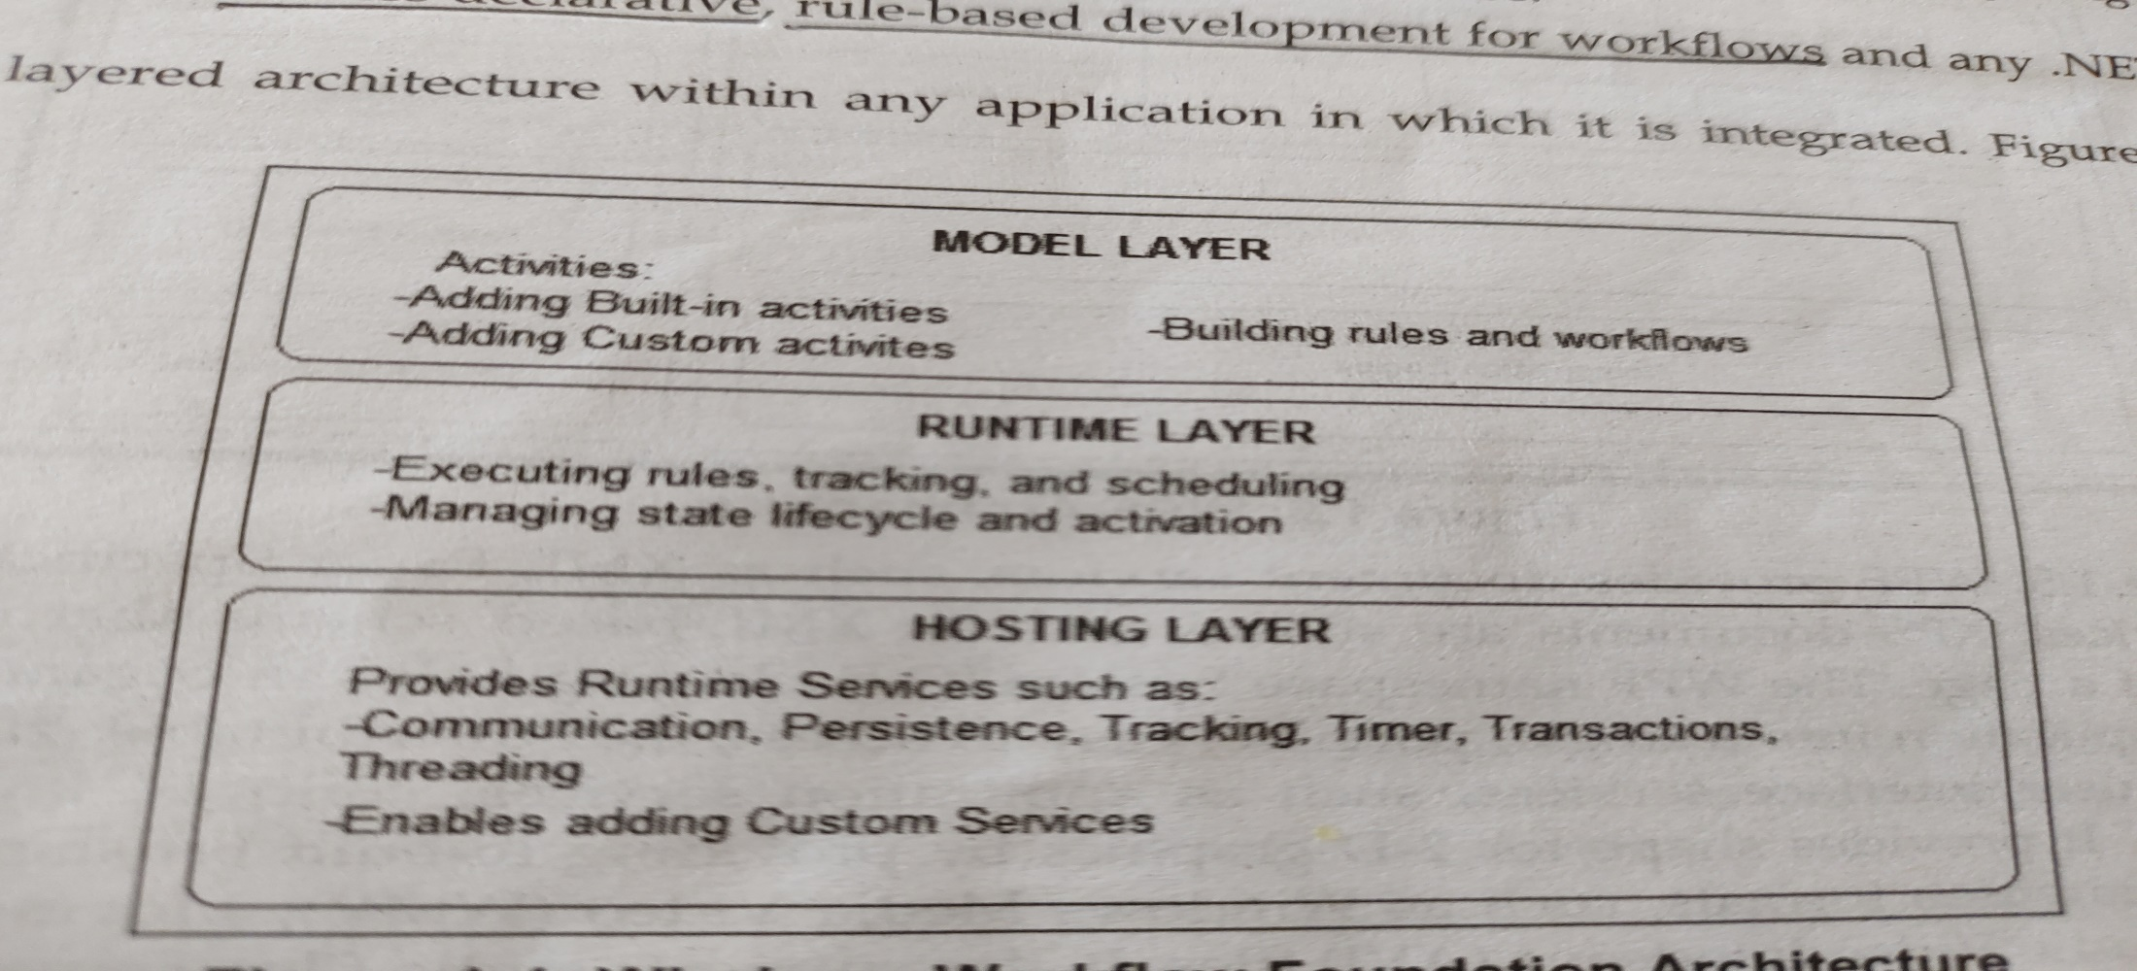
Windows Workflow Foundation (WWF)
Activities
Workflow designer
Workflow Runtime
Rules Engine

Slide 16
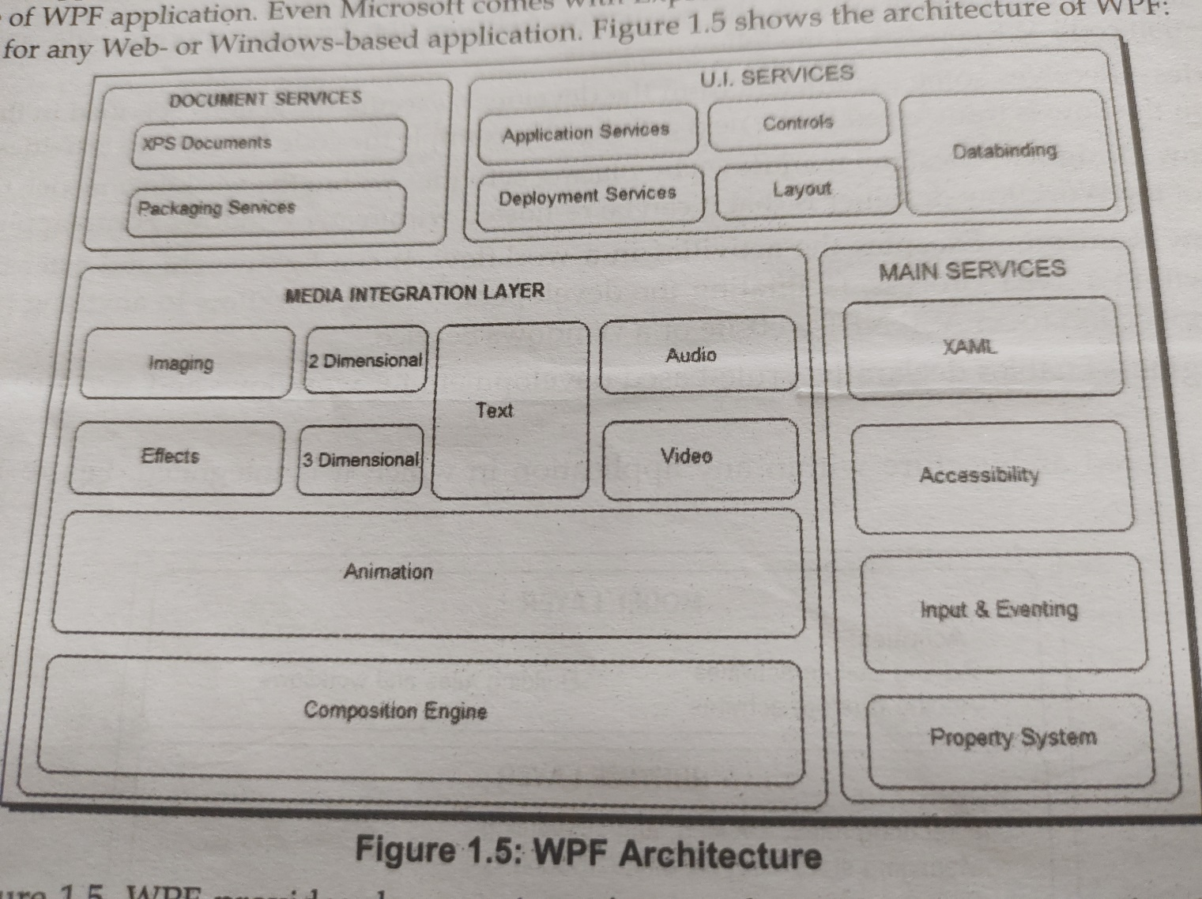
Windows Presentation Foundation (WPF)

Slide 17
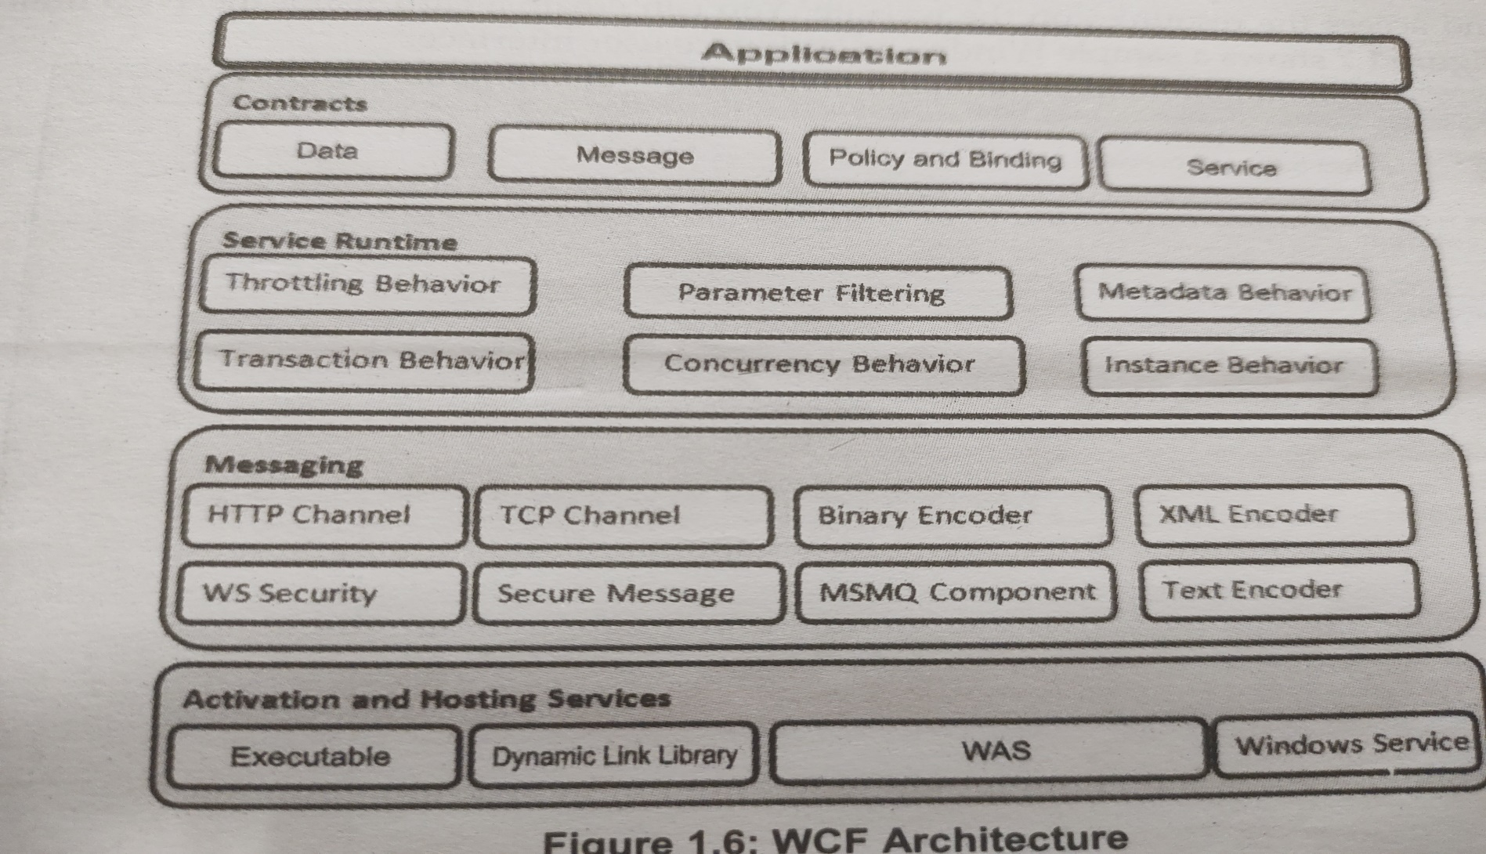
Windows Communication Foundation (WCF)

Slide 18
Exploring the features of Net Framework
Improvement in the application compatibility and deployment
Dynamic language runtime
Managed extensibility framework
Parallel computing
Improved security model
Networking improvement
Improvement in WPF
Improved entity framework
Integration of WCF and WF
Improved code ASP .Net services

Slide 19
Introduction to C# (C Sharp)
Microsoft C# (pronounced C Sharp) developed by Microsoft Corporation, USA
New programming language that runs on the .NET Framework
C# is simple, modern, type safe, and object oriented
C# code is compiled as managed code
Combines the best features of Visual Basic, C++ and Java
Notes:
Faculty Notes:
C# code is compiled as managed code, which means it benefits from the services of the common language runtime. These services include language interoperability, garbage collection, enhanced security, and improved versioning support.

Slide 20
C# Features
Type-Simple
Modern
Object-Oriented
Versionable
Compatible
Secure
Notes:
Faculty Notes:
Simple – It simplifies the use of operators such as -> :: and pointers. It treats integers and boolean data types as two different types.
Modern – because it supports:
Automatic garbage collection
Rich model for Error handling
Decimal Data type for Financial applications
Robust Security model
Object –Oriented:
Supports all the tenets of an object-oriented system
Encapsulation
Inheritance
Polymorphism
Type-Safe:
Dynamically allocated objects and arrays are initialized to zero
Access to arrays are range bound and warned if it goes out of bounds
C# enforces overflow checking in arithmetic operations
Reference parameters that are passed are type-safe
Versionable:
New versions of software's work with existing applications this is known as versioning
Compatible:
Enforces .NET common language specifications and there fore allows inter-operation with other .NET languages

Slide 21
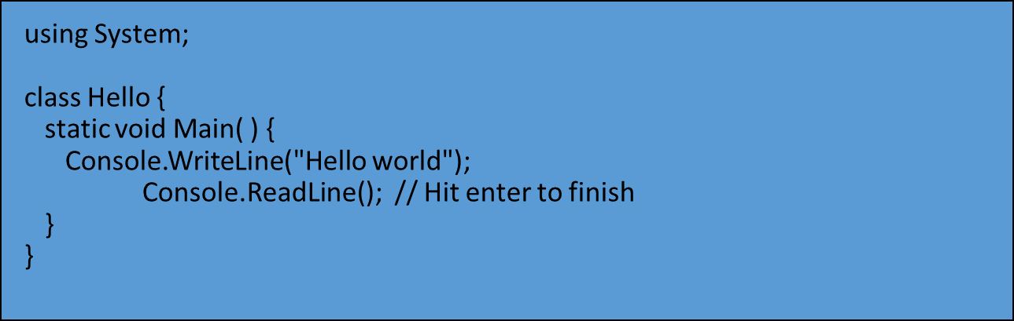
Sample Hello world program

Slide 22
Basics of C#
Identifier
Keywords
Operators
Variables
Literal
Constant
Expressions
Declaring statement
Executable statement

Slide 23
Creating console application
Understanding System namespace
Data types
Boolean
Byte
Char
Date
Decimal
Double
Integer
Long
Object
Declaring variable and constant

Slide 24
Most commonly used namespace
using System;
using System.Collections.Generic;
using System.Data;
using System.Drawing;
using System.Linq;
using System.Text;
using System.Windows.Forms;
using System.Data.SqlClient;

Slide 25
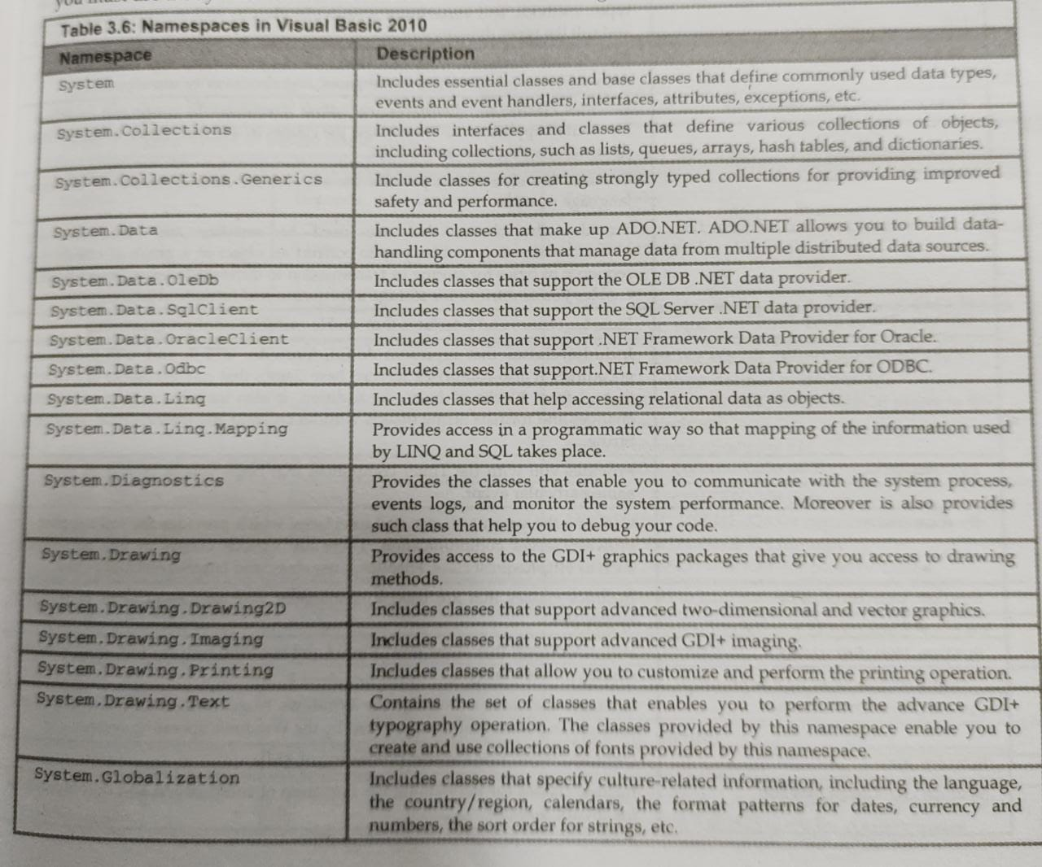

Slide 26
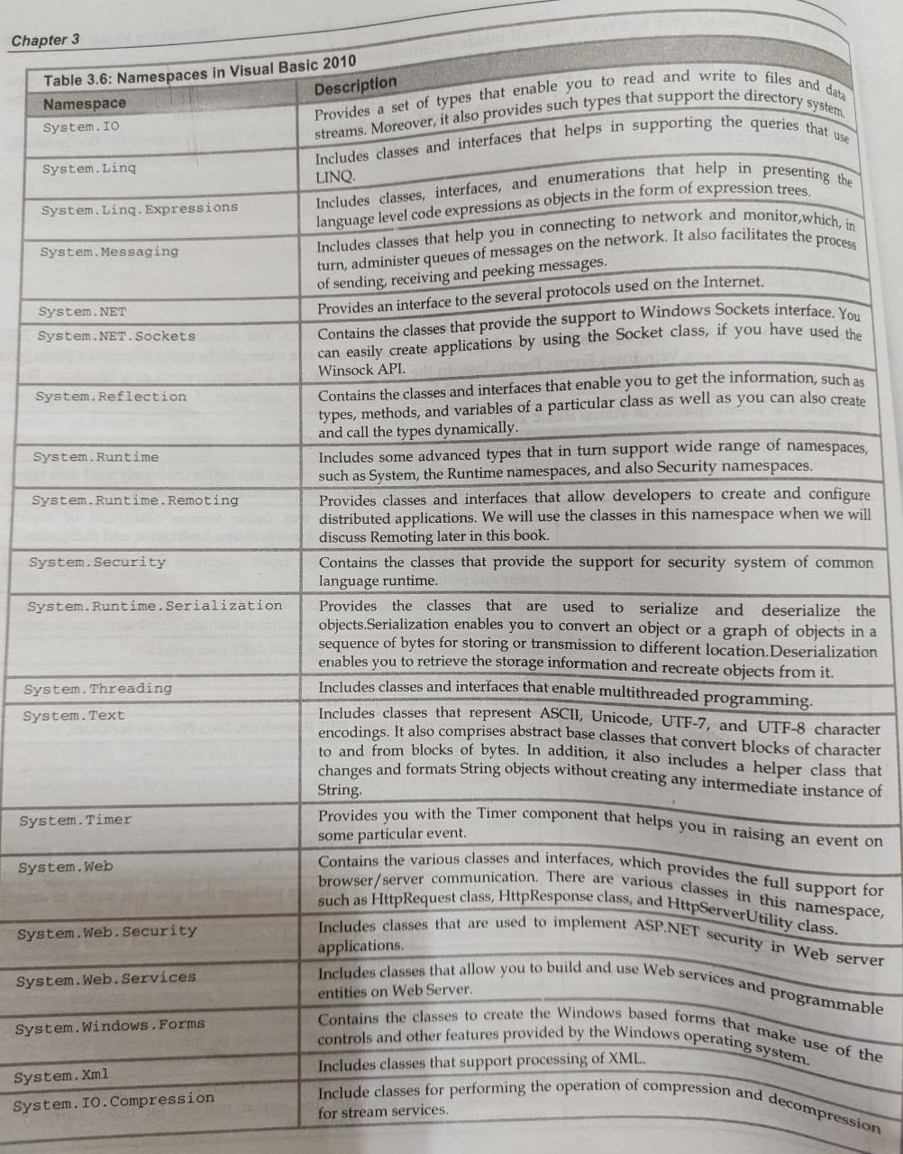

Slide 27
Introduction to C#

Slide 28
Prerequisites
This module assumes that you understand the fundamentals of
Programming
Variables, statements, functions, loops, etc.
Object-oriented programming
Classes, inheritance, polymorphism, members, etc.
C++ or Java
Notes:
The intent of this module is to teach the C# language, and how it differs from C++ and Java. It is not the intent of this module to teach how to program.

Slide 29
Learning Objectives
C# design goals
Fundamentals of the C# language
Types, program structure, statements, operators
Be able to begin writing and debugging C# programs
Using the .NET Framework SDK
Using Visual Studio.NET
Be able to write individual C# methods
Notes:
This module is designed to update C++ and Java programmers with the fundamentals of C#.

Slide 30
Hello World
using System;
class Hello {
static void Main( ) {
Console.WriteLine("Hello world");
Console.ReadLine(); // Hit enter to finish
}
}
Notes:
The Hello World application is very simple in C#. Some key points:
In C# there are no global methods. Everything belongs to a class.
A method named Main is the entry point for a C# application. Note that Main is spelled with a capital “M”, which is different than C and C++. The reason is that for consistency, all method names start with a capital letter in the .NET Framework
The line using System; means that we’ll be accessing members of the System namespace. In a very rough comparison, a namespace could be translated to a Unit in Turbo Pascal/Delphi or a .LIB file in C/C++. So in the Hello World example, the class Console, which contains the method WriteLine belongs to the System namespace. We could avoid the “using” statement by writing the complete path of the method: System.Console.WriteLine(“Hello World”);

Slide 31
Agenda
Hello World
Design Goals of C#
Types
Program Structure
Statements
Operators
Using Visual Studio.NET
Using the .NET Framework SDK

Slide 32
Design Goals of C# The Big Ideas
Component-orientation
Everything is an object
Robust and durable software
Preserving your investment
Notes:
First of all, C# was designed from the ground up to support components concepts like events, methods and properties.
Second, everything is an object, which allows us to create some really clean designs.
Third, it was designed to make it easy to create robust and maintainable software
And finally, it should be able to integrate easily with everything that already exists, preserving your investment.

Slide 33
Design Goals of C# Component-Orientation
C# is the first “Component-Oriented” language in the C/C++ family
What is a component?
An independent module of reuse and deployment
Coarser-grained than objects (objects are language-level constructs)
Includes multiple classes
Often language-independent
In general, component writer and user don’t know each other, don’t work for the same company, and don’t use the same language
Notes:
C# is component-oriented, but first, what is a component? The definition of a component is still contentious. However, there is agreement that components address issues of reuse and deployment, as opposed to objects, which are language-specific concepts.

Slide 34
Design Goals of C# Component-Orientation
Component concepts are first class
Properties, methods, events
Design-time and run-time attributes
Integrated documentation using XML
Enables “one-stop programming”
No header files, IDL, etc.
Can be embedded in ASP pages
Notes:
C# is a Component Oriented Language
First of all, C# was designed from the ground up to support components. It is the first language in the C/C++ family to support the concepts of components. But what defines a component? Basically it is the not only classes and methods, but also properties and events. It is not that is not possible to do component based development in C++, but you must rely usually on coding conventions like to define a property, let’s name this method as GetSomething and SetSomething. If you want to support events then it means that you need to implement this and that interface. In C#, the concept of properties, methods and events are all native. In fact, C++ only supports the concept of methods. Just as an analogy, it is not impossible to write object oriented programs in C, it is only harder than in C++. The same applies to component based development in C++ vs. C#.
Also when you move to component based development you have to think in a number of other factors like separate files to describe my components, like header files in C++, IDL to describe component interfaces and so on. In C# none of these are needed since it has built-in support for these concepts, enabling what we call one stop programming, so everything can be described in the source code, instead of requiring separate files.

Slide 35
Design Goals of C# Everything is an Object
Traditional views
C++, Java™: Primitive types are “magic” and do not interoperate with objects
Smalltalk, Lisp: Primitive types are objects, but at some performance cost
C# unifies with no performance cost
Deep simplicity throughout system
Improved extensibility and reusability
New primitive types: Decimal, SQL…
Collections, etc., work for all types
Notes:
Everything is an Object
There are two different schools here: the purists like Smalltalk where everything is an object and C++ or Java, where primitive types are treated differently for performance reasons. Typically, when everything is an object, it means that every time that you do a simple operation like adding to numbers, it will incur on a heap allocation, which is quite expensive from the CPU standpoint compared to a stack allocated piece of memory. On the other hand, when languages threat primitive types as magic types, it means that if you implement a generic class, like a collection or array, it is not truly generic, because you either have to implement one version for each primitive type or you have to write wrapper classes to each of the primitive types so they can behave as an object.
In C#, it is possible if you declare a primitive type, it is created on the stack, with all performance benefits that this brings. However it is possible to assign an integer to an object, and the runtime will automatically allocate the memory on the heap to accommodate the integer and threat it as an object. This happens automatically without requiring the programmer to write an wrapper class.
Just as a side note for VB programmers: you can compare a stack allocation to a stack of paper where you can only write to the top page. As soon as you enter a function or sub you get a new page and you’re done (exit the function) you just throw away the top page. Let’s say that garbage management is really simple in this scenario.
Heap allocation is like having multiple pages at your disposal and also they don’t necessary vanish when your function ends. You can imagine that it is a lot more complex, because a piece of data on page 2 could be disposed, but another piece on the same page could still be needed by a different part of the code. In other words, a lot more management is necessary.

Slide 36
Design Goals of C# Robust and Durable Software
Garbage collection
No memory leaks and stray pointers
Exceptions
Type-safety
No uninitialized variables, no unsafe casts
Versioning
Avoid common errors
E.g. if (x = y) ...
One-stop programming
Fewer moving parts
Notes:
Prevent common mistakes from other languages
C# has a lot of features to make it easier to create robust software.
Every C++ programmer knows how easy is to have a pointer to an object that was already de-allocated. C# provides automatically garbage collection through the Common Language Runtime.
Also, if you think about how error were handle in most of the code today, they’re mostly based on checking return codes. Exceptions provides a way to write a less code while at the same time providing a much more robust error handling mechanism. Not only exception handling is implemented in the language but it is also a inherent part of the .NET Framework
Another point is that all variables are automatically initialised and it is impossible to do unsafe casts.
Finally, C# is one of the first languages that provides a versioning semantics to easily support old and new clients.

Slide 37
Design Goals of C# Preserving Your Investment
C++ Heritage
Namespaces, pointers (in unsafe code), unsigned types, etc.
Some changes, but no unnecessary sacrifices
Interoperability
What software is increasingly about
C# talks to XML, SOAP, COM, DLLs, and any .NET Framework language
Increased productivity
Short learning curve
Millions of lines of C# code in .NET
Notes:
Leverage C++ knowledge, interoperability and rich class library
First of all, since C# was based on C++, C++ programmers will adapt really quick.
Second, interoperability is a key theme in the .NET Framework. So it is really easy to integrate C# code with existing applications
Finally, the .NET Framework provides a very, very rich set of services that will make developers really productive.

Slide 38
Agenda
Hello World
Design Goals of C#
Types
Program Structure
Statements
Operators
Using Visual Studio.NET
Using the .NET Framework SDK

Slide 39
Types Overview
A C# program is a collection of types
Classes, structs, enums, interfaces, delegates
C# provides a set of predefined types
E.g. int, byte, char, string, object, …
You can create your own types
All data and code is defined within a type
No global variables, no global functions
Notes:
In most other purely object-oriented languages one would say that a program is a collection of classes.
Not all types have all capabilities; e.g. enums are fairly constrained.

Slide 40
Types Overview
Types contain:
Data members
Fields, constants, arrays
Events
Function members
Methods, operators, constructors, destructors
Properties, indexers
Other types
Classes, structs, enums, interfaces, delegates

Slide 41
Types Overview
Types can be instantiated…
…and then used: call methods, get and set properties, etc.
Can convert from one type to another
Implicitly and explicitly
Types are organized
Namespaces, files, assemblies
There are two categories of types: value and reference
Types are arranged in a hierarchy

Slide 42
Types Unified Type System
Value types
Directly contain data
Cannot be null
Reference types
Contain references to objects
May be null
int i = 123;
string s = "Hello world";
i
123
s
"Hello world"
Notes:
In C# you have value types that directly hold the data on the stack and reference types that keeps a reference on the stack, but allocates the real memory on the heap.
Also have pointer types in unsafe code. Will discuss those in Part 2.

Slide 43
Types Unified Type System
Value types
Primitives int i; float x;
Enums enum State { Off, On }
Structs struct Point {int x,y;}
Reference types
Root object
String string
Classes class Foo: Bar, IFoo {...}
Interfaces interface IFoo: IBar {...}
Arrays string[] a = new string[10];
Delegates delegate void Empty();
Notes:
Structs and classes can be user-defined.

Slide 44
Types Unified Type System
 | Value (Struct) | Reference (Class)
Variable holds | Actual value | Memory location
Allocated on | Stack, member | Heap
Nullability | Always has value | May be null
Default value | 0 | null
Aliasing (in a scope) | No | Yes
Assignment means | Copy data | Copy reference

Slide 45
Types Unified Type System
Benefits of value types
No heap allocation, less GC pressure
More efficient use of memory
Less reference indirection
Unified type system
No primitive/object dichotomy

Slide 46
Types Conversions
Implicit conversions
Occur automatically
Guaranteed to succeed
No information (precision) loss
Explicit conversions
Require a cast
May not succeed
Information (precision) might be lost
Both implicit and explicit conversions can be user-defined

Slide 47
Types Conversions
int x = 123456;
long y = x; // implicit
short z = (short)x; // explicit
double d = 1.2345678901234;
float f = (float)d; // explicit
long l = (long)d; // explicit

Slide 48
Object
Everything is an object
All types ultimately inherit from object
Any piece of data can be stored, transported, and manipulated with no extra work
Notes:
Everything inherits from object, including primitive types, structs or classes.

Slide 49
Types Unified Type System
Polymorphism
The ability to perform an operation on an object without knowing the precise type of the object
void Poly(object o) {
Console.WriteLine(o.ToString());
}
Poly(42);
Poly(“abcd”);
Poly(12.345678901234m);
Poly(new Point(23,45));
Notes:
The example shows a function, Poly(), that is called with different types of arguments.

Slide 50
Hint
How does an int (value type) get converted into an object (reference type)?
Answer: Boxing!
Only value types get boxed
Reference types do not get boxed

Slide 51
Boxing and Unboxing
Boxing
Copies a value type into a reference type (object)
Each value type has corresponding “hidden” reference type
Note that a reference-type copy is made of the value type
Value types are never aliased
Value type is converted implicitly to object, a reference type
Essentially an “up cast”
Unboxing
Inverse operation of boxing
Copies the value out of the box
Copies from reference type to value type
Requires an explicit conversion
May not succeed (like all explicit conversions)
Essentially a “down cast”
Notes:
Boxing and Unboxing is one of the key innovations of C# language. Instead of requiring the programmer to write wrapper code to convert from stack based memory to heap memory, you just need to assign a value type to an object and C# takes care of allocating the memory in the heap and generating a copy of that on the heap. When you assign the object to a stack based int, the value is converted to the stack again. This process is what we call Boxing and Unboxing.
If an int is boxed, it still knows it’s an int.

Slide 52
Boxing and unboxing
int i = 123;
object o = i;
int j = (int)o;
i
123
o
System.Int32
123
j
123

Slide 53
Benefits of boxing
Enables polymorphism across all types
Collection classes work with all types
Eliminates need for wrapper classes
Replaces OLE Automation's Variant
Lots of examples in .NET Framework
using System;
namespace labproject
{
class program2
{
/* c# program -Boxing and UnBoxing */
public static void Main()
{
Console.WriteLine ("Enter the Number");
int n = int.Parse (Console.ReadLine ());
object ob = n;
Console.WriteLine ("The Value of ob is {0}", ob);
int s = (int)ob;
Console.WriteLine ("The Value of s is {0}", s);
Console.ReadLine();
} } }
Notes:
Main benefits of the Unified Type System:
No need of wrapper code to use base types in collections or arrays
No Variants anymore

Slide 54
Types Unified Type System
Disadvantages of boxing
Performance cost
The need for boxing will decrease when the CLR supports generics (similar to C++ templates)

Slide 55
Types Predefined Types
Value
Integral types
Floating point types
decimal
bool
char
Reference
object
string

Slide 56
Predefined Types Value Types
All are predefined structs
Signed | sbyte, short, int, long
Unsigned | byte, ushort, uint, ulong
Character | char
Floating point | float, double, decimal
Logical | bool

Slide 57
Predefined Types Integral Types
C# Type | System Type | Size (bytes) | Signed?
sbyte | System.Sbyte | 1 | Yes
short | System.Int16 | 2 | Yes
int | System.Int32 | 4 | Yes
long | System.Int64 | 8 | Yes
byte | System.Byte | 1 | No
ushort | System.UInt16 | 2 | No
uint | System.UInt32 | 4 | No
ulong | System.UInt64 | 8 | No

Slide 58
Predefined Types Floating Point Types
Follows IEEE 754 specification
Supports ± 0, ± Infinity, NaN
C# Type | System Type | Size (bytes)
float | System.Single | 4
double | System.Double | 8

Slide 59
Predefined Types decimal
128 bits
Essentially a 96 bit value scaled by a power of 10
Decimal values represented precisely
Doesn’t support signed zeros, infinities or NaN
C# Type | System Type | Size (bytes)
decimal | System.Decimal | 16

Slide 60
Predefined Types decimal
All integer types can be implicitly converted to a decimal type
Conversions between decimal and floating types require explicit conversion due to possible loss of precision
s * m * 10e
s = 1 or –1
0 ≤ m ≤ 296
-28 ≤ e ≤ 0

Slide 61
Predefined Types Integral Literals
Integer literals can be expressed as decimal or hexadecimal
U or u: uint or ulong
L or l: long or ulong
UL or ul: ulong
123 // Decimal
0x7B // Hexadecimal
123U // Unsigned
123ul // Unsigned long
123L // Long

Slide 62
Predefined Types Real Literals
F or f: float
D or d: double
M or m: decimal
123f // Float
123D // Double
123.456m // Decimal
1.23e2f // Float
12.3E1M // Decimal

Slide 63
Predefined Types bool
Represents logical values
Literal values are true and false
Cannot use 1 and 0 as boolean values
No standard conversion between other types and bool
C# Type | System Type | Size (bytes)
bool | System.Boolean | 1 (2 for arrays)
Notes:
Eliminating implicit conversions between numbers and bool can help find subtle bugs.

Slide 64
Predefined Types char
Represents a Unicode character
Literals
‘A’ // Simple character
‘\u0041’ // Unicode
‘\x0041’ // Unsigned short hexadecimal
‘\n’ // Escape sequence character
C# Type | System Type | Size (bytes)
Char | System.Char | 2

Slide 65
Predefined Types char
Escape sequence characters (partial list)
Char | Meaning | Value
\’ | Single quote | 0x0027
\” | Double quote | 0x0022
\\ | Backslash | 0x005C
\0 | Null | 0x0000
\n | New line | 0x000A
\r | Carriage return | 0x000D
\t | Tab | 0x0009

Slide 66
Predefined Types Reference Types
Root type | object
Character string | string

Slide 67
Predefined Types object
Root of object hierarchy
Storage (book keeping) overhead
0 bytes for value types
8 bytes for reference types
An actual reference (not the object) uses 4 bytes
C# Type | System Type | Size (bytes)
object | System.Object | 0/8 overhead

Slide 68
Predefined Types object Public Methods
public bool Equals(object)
protected void Finalize()
public int GetHashCode()
public System.Type GetType()
protected object MemberwiseClone()
public void Object()
public string ToString()

Slide 69
Predefined Types string
An immutable sequence of Unicode characters
Reference type
Special syntax for literals
string s = “I am a string”;
C# Type | System Type | Size (bytes)
String | System.String | 20 minimum

Slide 70
Predefined Types string
Normally have to use escape characters
Verbatim string literals
Most escape sequences ignored
Except for “”
Verbatim literals can be multi-line
string s1= “\\\\server\\fileshare\\filename.cs”;
string s2 = @“\\server\fileshare\filename.cs”;

Slide 71
Types User-defined Types
User-defined types
Enumerations | enum
Arrays | int[], string[]
Interface | interface
Reference type | class
Value type | struct
Function pointer | delegate

Slide 72
Types Enums
An enum defines a type name for a related group of symbolic constants
Choices must be known at compile-time
Strongly typed
No implicit conversions to/from int
Can be explicitly converted
Operators: +, -, ++, --, &, |, ^, ~, …
Can specify underlying type
byte, sbyte, short, ushort, int, uint, long, ulong
Notes:
Enums in C# are strongly typed, which means that you can’t assign a int enum to a long, or vice versa, avoiding some typical conversion mistakes.

Slide 73
Types Enums
enum Color: byte {
Red = 1,
Green = 2,
Blue = 4,
Black = 0,
White = Red | Green | Blue
}
Color c = Color.Black;
Console.WriteLine(c); // 0
Console.WriteLine(c.Format()); // Black

Slide 74
Types Enums
All enums derive from System.Enum
Provides methods to
determine underlying type
test if a value is supported
initialize from string constant
retrieve all values in enum
…

Slide 75
Types Arrays
Arrays allow a group of elements of a specific type to be stored in a contiguous block of memory
Arrays are reference types
Derived from System.Array
Zero-based
Can be multidimensional
Arrays know their length(s) and rank
Bounds checking

Slide 76
Types Arrays
Declare
Allocate
Initialize
Access and assign
Enumerate
int[] primes;
int[] primes = new int[9];
int[] prime = new int[] {1,2,3,5,7,11,13,17,19}; int[] prime = {1,2,3,5,7,11,13,17,19};
prime2[i] = prime[i];
foreach (int i in prime) Console.WriteLine(i);

Slide 77
Types Arrays
Multidimensional arrays
Rectangular
int[,] matR = new int[2,3];
Can initialize declaratively
int[,] matR = new int[2,3] { {1,2,3}, {4,5,6} };
Jagged
An array of arrays
int[][] matJ = new int[2][];
Must initialize procedurally

Slide 78
Types Interfaces
An interface defines a contract
Includes methods, properties, indexers, events
Any class or struct implementing an interface must support all parts of the contract
Interfaces provide polymorphism
Many classes and structs may implement a particular interface
Contain no implementation
Must be implemented by a class or struct
Notes:
In scenarios where completely different objects need to support some kind of shared functionality like, let’s say, persist to XML, classes can implement interfaces that make then compatible with even if they don’t share the same base class. This provides most of the benefits of multiple class inheritance without the nasty side-effects that this usually brings.

Slide 79
Types Classes
User-defined reference type
Similar to C++, Java classes
Single class inheritance
Multiple interface inheritance
Notes:
Classes in C# allow single inheritance and multiple interface inheritance. Each class can contain methods, properties, events, indexers, constants, constructors, destructors, operators and members can be static (can be accessed without an object instance) or instance member (require you to have a reference to an object first)

Slide 80
Types Classes
Members
Constants, fields, methods, operators, constructors, destructors
Properties, indexers, events
Static and instance members
Member access
public, protected, private, internal, protected internal
Default is private
Instantiated with new operator
Notes:
protected internal = protected OR internal

Slide 81
Types Structs
Similar to classes, but
User-defined value type
Always inherits from object
Ideal for lightweight objects
int, float, double, etc., are all structs
User-defined “primitive” types
Complex, point, rectangle, color, rational
Multiple interface inheritance
Same members as class
Member access
public, internal, private
Instantiated with new operator
Notes:
To provide a really high performance object type, C# provides structs, which are stack allocated. They’re ideal for small objects and are really fast since they don’t depend on dynamic memory allocation and the garbage collector. It is also important to notice that it is not possible to inherit from an struct.
No protected access because there is no inheritance.

Slide 82
Types Classes and Structs
struct SPoint { int x, y; ... }
class CPoint { int x, y; ... }
SPoint sp = new SPoint(10, 20);
CPoint cp = new CPoint(10, 20);
10
sp
20
cp
CPoint
10
20
Notes:
Again, comparing classes and structs, it is the memory layout of a struct is just a direct representation of its members directly on the stack. On a class, a reference is stored on the stack, while the object itself is stored in the heap.

Slide 83
Types Delegates
A delegate is a reference type that defines a method signature
When instantiated, a delegate holds one or more methods
Essentially an object-oriented function pointer
Foundation for framework events

Slide 84
Agenda
Hello World
Design Goals of C#
Types
Program Structure
Statements
Operators
Using Visual Studio.NET
Using the .NET Framework SDK

Slide 85
Program Structure Overview
Organizing Types
Namespaces
References
Main Method
Syntax

Slide 86
Program Structure Organizing Types
Physical organization
Types are defined in files
Files are compiled into modules
Modules are grouped into assemblies
Assembly
Module
File
Type

Slide 87
Program Structure Organizing Types
Types are defined in files
A file can contain multiple types
Each type is defined in a single file
Files are compiled into modules
Module is a DLL or EXE
A module can contain multiple files
Modules are grouped into assemblies
Assembly can contain multiple modules
Assemblies and modules are often 1:1

Slide 88
Program Structure Organizing Types
Types are defined in ONE place
“One-stop programming”
No header and source files to synchronize
Code is written “in-line”
Declaration and definition are one and the same
A type must be fully defined in one file
Can’t put individual methods in different files
No declaration order dependence
No forward references required

Slide 89
Program Structure Namespaces
Namespaces provide a way to uniquely identify a type
Provides logical organization of types
Namespaces can span assemblies
Can nest namespaces
There is no relationship between namespaces and file structure (unlike Java)
The fully qualified name of a type includes all namespaces

Slide 90
Program Structure Namespaces
namespace N1 { // N1
class C1 { // N1.C1
class C2 { // N1.C1.C2
}
}
namespace N2 { // N1.N2
class C2 { // N1.N2.C2
}
}
}
Notes:
The comments show the fully qualified names.
A namespace called N3.N4 is like two nested namespaces.

Slide 91
Program Structure Namespaces
The using statement lets you use types without typing the fully qualified name
Can always use a fully qualified name
using N1;
C1 a; // The N1. is implicit
N1.C1 b; // Fully qualified name
C2 c; // Error! C2 is undefined
N1.N2.C2 d; // One of the C2 classes
C1.C2 e; // The other one
Notes:
Note that it is N1.C1, not N1::C1
The using statement is scoped by the namespace and/or compilation module containing it.

Slide 92
Program Structure Namespaces
The using statement also lets you create aliases
using C1 = N1.N2.C1;
using N2 = N1.N2;
C1 a; // Refers to N1.N2.C1
N2.C1 b; // Refers to N1.N2.C1

Slide 93
Program Structure Namespaces
Best practice: Put all of your types in a unique namespace
Have a namespace for your company, project, product, etc.
Look at how the .NET Framework classes are organized

Slide 94
Program Structure References
In Visual Studio you specify references for a project
Each reference identifies a specific assembly
Passed as reference (/r or /reference) to the C# compiler
csc HelloWorld.cs /reference:System.WinForms.dll

Slide 95
Program Structure Namespaces vs. References
Namespaces provide language-level naming shortcuts
Don’t have to type a long fully qualified name over and over
References specify which assembly to use

Slide 96
Program Structure Main Method
Execution begins at the static Main() method
Can have only one method with one of the following signatures in an assembly
static void Main()
static int Main()
static void Main(string[] args)
static int Main(string[] args)

Slide 97
Program Structure Syntax
Identifiers
Names for types, methods, fields, etc.
Must be whole word – no white space
Unicode characters
Begins with letter or underscore
Case sensitive
Must not clash with keyword
Unless prefixed with @

Slide 98
Agenda
Hello World
Design Goals of C#
Types
Program Structure
Statements
Operators
Using Visual Studio.NET
Using the .NET Framework SDK

Slide 99
Statements Overview
High C++ fidelity
if, while, do require bool condition
goto can’t jump into blocks
switch statement
No fall-through
foreach statement
checked and unchecked statements
Expression statements must do work
void Foo() {
i == 1; // error
}
Notes:
In the Statements and Expressions area C# is just like C++ with some key differences to improve code robustness. Other than solving the old assignment problem in if statements, goto usage is limited to safer scenarios and switch statements require break between each options avoiding the infamous fall through bug.
Also C# has a foreach statement to iterate through arrays and collections

Slide 100
Statements Overview
Statement lists
Block statements
Labeled statements
Declarations
Constants
Variables
Expression statements
checked, unchecked
lock
using
Conditionals
if
switch
Loop Statements
while
do
for
foreach
Jump Statements
break
continue
goto
return
throw
Exception handling
try
throw

Slide 101
Statements Syntax
Statements are terminated with a semicolon (;)
Just like C, C++ and Java
Block statements { ... } don’t need a semicolon

Slide 102
Statements Syntax
Comments
// Comment a single line, C++ style
/* Comment multiple lines, C style */

Slide 103
Statements Statement Lists & Block Statements
Statement list: one or more statements in sequence
Block statement: a statement list delimited by braces { ... }
static void Main() {
F();
G();
{ // Start block
H();
; // Empty statement
I();
} // End block
}

Slide 104
Statements Variables and Constants
static void Main() {
const float pi = 3.14f;
const int r = 123;
Console.WriteLine(pi * r * r);
int a;
int b = 2, c = 3;
a = 1;
Console.WriteLine(a + b + c);
}

Slide 105
Statements Variables and Constants
The scope of a variable or constant runs from the point of declaration to the end of the enclosing block

Slide 106
Statements Variables and Constants
Within the scope of a variable or constant it is an error to declare another variable or constant with the same name
{
int x;
{
int x; // Error: can’t hide variable x
}
}

Slide 107
Statements Variables
Variables must be assigned a value before they can be used
Explicitly or automatically
Called definite assignment
Automatic assignment occurs for static fields, class instance fields and array elements
void Foo() {
string s;
Console.WriteLine(s); // Error
}

Slide 108
Statements Labeled Statements & goto
goto can be used to transfer control within or out of a block, but not into a nested block
static void Find(int value, int[,] values,
out int row, out int col) {
int i, j;
for (i = 0; i < values.GetLength(0); i++)
for (j = 0; j < values.GetLength(1); j++)
if (values[i, j] == value) goto found;
throw new InvalidOperationException(“Not found");
found:
row = i; col = j;
}
Notes:
Also used in switch statements

Slide 109
Expression Statements
Statements must do work
Assignment, method call, ++, --, new
static void Main() {
int a, b = 2, c = 3;
a = b + c;
a++;
MyClass.Foo(a,b,c);
Console.WriteLine(a + b + c);
a == 2; // ERROR!
}
Notes:
Expression statements must do work.

Slide 110
Statements if Statement
Requires bool expression
int Test(int a, int b) {
if (a > b)
return 1;
else if (a < b)
return -1;
else
return 0;
}
Notes:
Like C, C++ and Java, beware of dangling elses!

Slide 111
Statements switch Statement
Can branch on any predefined type (including string) or enum
User-defined types can provide implicit conversion to these types
Must explicitly state how to end case
With break, goto case, goto label, return, throw or continue
Eliminates fall-through bugs
Not needed if no code supplied after the label

Slide 112
Statements switch Statement
int Test(string label) {
int result;
switch(label) {
case null:
goto case “runner-up”;
case “fastest”:
case “winner”:
result = 1; break;
case “runner-up”:
result = 2; break;
default:
result = 0;
}
return result;
}

Slide 113
Statements while Statement
Requires bool expression
int i = 0;
while (i < 5) {
...
i++;
}
int i = 0;
do {
...
i++;
}
while (i < 5);
while (true) {
...
}

Slide 114
Statements for Statement
for (int i=0; i < 5; i++) {
...
}
for (;;) {
...
}
Notes:
Just like C++ and Java.

Slide 115
Statements foreach Statement
Iteration of arrays
public static void Main(string[] args) {
foreach (string s in args)
Console.WriteLine(s);
}
Notes:
No need to have loops with explicit bounds checking. Just use foreach.

Slide 116
Statements foreach Statement
Iteration of user-defined collections
Created by implementing IEnumerable
foreach (Customer c in customers.OrderBy("name")) {
if (c.Orders.Count != 0) {
...
}
}

Slide 117
Statements Jump Statements
break
Exit inner-most loop
continue
End iteration of inner-most loop
goto <label>
Transfer execution to label statement
return [<expression>]
Exit a method
throw
See exception handling
Notes:
There is no break <label> or continue <label>.

Slide 118
Statements Exception Handling
Exceptions are the C# mechanism for handling unexpected error conditions
Superior to returning status values
Can’t be ignored
Don’t have to handled at the point they occur
Can be used even where values are not returned (e.g. accessing a property)
Standard exceptions are provided

Slide 119
Statements Exception Handling
try...catch...finally statement
try block contains code that could throw an exception
catch block handles exceptions
Can have multiple catch blocks to handle different kinds of exceptions
finally block contains code that will always be executed
Cannot use jump statements (e.g. goto) to exit a finally block

Slide 120
Statements Exception Handling
throw statement raises an exception
An exception is represented as an instance of System.Exception or derived class
Contains information about the exception
Properties
Message
StackTrace
InnerException
You can rethrow an exception, or catch one exception and throw another
Notes:
You can define your own exceptions by deriving it from System.Exception.

Slide 121
Statements Exception Handling
try {
Console.WriteLine("try");
throw new Exception(“message”);
}
catch (ArgumentNullException e) {
Console.WriteLine(“caught null argument");
}
catch {
Console.WriteLine("catch");
}
finally {
Console.WriteLine("finally");
}
Notes:
This will print:
try
catch
finally

Slide 122
Statements Synchronization
Multi-threaded applications have to protect against concurrent access to data
Must prevent data corruption
The lock statement uses an instance to provide mutual exclusion
Only one lock statement can have access to the same instance
Actually uses the .NET Framework System.Threading.Monitor class to provide mutual exclusion
Notes:
Unlike Java, you cannot specify that an entire method be locked. Experience has shown that usually an entire method does not have to be locked. Since you want to hold locks as short a period of time as possible, C# doesn’t allow you to specify it for a method.

Slide 123
Statements Synchronization
public class CheckingAccount {
decimal balance;
public void Deposit(decimal amount) {
lock (this) {
balance += amount;
}
}
public void Withdraw(decimal amount) {
lock (this) {
balance -= amount;
}
}
}
Notes:
Two threads can call methods on CheckingAccount concurrently, but only one will be able to update balance at a time. This will prevent balance from becoming corrupted.

Slide 124
Statements using Statement
C# uses automatic memory management (garbage collection)
Eliminates most memory management problems
However, it results in non-deterministic finalization
No guarantee as to when and if object destructors are called

Slide 125
Statements using Statement
Objects that need to be cleaned up after use should implement the System.IDisposable interface
One method: Dispose()
The using statement allows you to create an instance, use it, and then ensure that Dispose is called when done
Dispose is guaranteed to be called, as if it were in a finally block
Notes:
The using statement is not in Beta 1

Slide 126
Statements using Statement
public class MyResource : IDisposable {
public void MyResource() {
// Acquire valuble resource
}
public void Dispose() {
// Release valuble resource
}
public void DoSomething() {
...
}
}
using (MyResource r = new MyResource()) {
r.DoSomething();
} // r.Dispose() is called

Slide 127
Statements checked and unchecked Statements
The checked and unchecked statements allow you to control overflow checking for integral-type arithmetic operations and conversions
checked forces checking
unchecked forces no checking
Can use both as block statements or as an expression
Default is unchecked
Use the /checked compiler option to make checked the default

Slide 128
Statements Basic Input/Output Statements
Console applications
System.Console.WriteLine();
System.Console.ReadLine();
Windows applications
System.WinForms.MessageBox.Show();
string v1 = “some value”;
MyObject v2 = new MyObject();
Console.WriteLine(“First is {0}, second is {1}”,
v1, v2);

Slide 129
Agenda
Hello World
Design Goals of C#
Types
Program Structure
Statements
Operators
Using Visual Studio.NET
Using the .NET Framework SDK

Slide 130
Operators Overview
C# provides a fixed set of operators, whose meaning is defined for the predefined types
Some operators can be overloaded (e.g. +)
The following table summarizes the C# operators by category
Categories are in order of decreasing precedence
Operators in each category have the same precedence
Notes:
The + operator is overloaded to mean addition for numbers and concatenation for strings.

Slide 131
Operators Precedence
Category | Operators
Primary | Grouping: (x) Member access: x.y Method call: f(x) Indexing: a[x] Post-increment: x++ Post-decrement: x— Constructor call: new Type retrieval: typeof Arithmetic check on: checked Arithmetic check off: unchecked

Slide 132
Operators Precedence
Category | Operators
Unary | Positive value of: + Negative value of: - Not: ! Bitwise complement: ~ Pre-increment: ++x Post-decrement: --x Type cast: (T)x
Multiplicative | Multiply: * Divide: / Division remainder: %

Slide 133
Operators Precedence
Category | Operators
Additive | Add: + Subtract: -
Shift | Shift bits left: << Shift bits right: >>
Relational | Less than: < Greater than: > Less than or equal to: <= Greater than or equal to: >= Type equality/compatibility: is Type conversion: as

Slide 134
Operators Precedence
Category | Operators
Equality | Equals: == Not equals: !=
Bitwise AND | &
Bitwise XOR | ^
Bitwise OR | |
Logical AND | &&
Logical OR | ||

Slide 135
Operators Precedence
Category | Operators
Ternary conditional | ?:
Assignment | =, *=, /=, %=, +=, -=, <<=, >>=, &=, ^=, |=

Slide 136
Operators Associativity
Assignment and ternary conditional operators are right-associative
Operations performed right to left
x = y = z evaluates as x = (y = z)
All other binary operators are left-associative
Operations performed left to right
x + y + z evaluates as (x + y) + z
Use parentheses to control order

Slide 137
Agenda
Hello World
Design Goals of C#
Types
Program Structure
Statements
Operators
Using Visual Studio.NET
Using the .NET Framework SDK

Slide 138
Using Visual Studio.NET
Types of projects
Console Application
Windows Application
Web Application
Web Service
Windows Service
Class Library
...

Slide 139
Using Visual Studio.NET
Windows
Solution Explorer
Class View
Properties
Output
Task List
Object Browser
Server Explorer
Toolbox

Slide 140
Using Visual Studio.NET
Building
Debugging
Break points
References
Saving

Slide 141
Agenda
Hello World
Design Goals of C#
Types
Program Structure
Statements
Operators
Using Visual Studio.NET
Using the .NET Framework SDK

Slide 142
Using .NET Framework SDK
Compiling from command line
csc /r:System.WinForms.dll class1.cs file1.cs

Slide 143
More Resources
http://msdn.microsoft.com
http://windows.oreilly.com/news/hejlsberg_0800.html
http://www.csharphelp.com/
http://www.csharp-station.com/
http://www.csharpindex.com/
http://msdn.microsoft.com/msdnmag/issues/0900/csharp/csharp.asp
http://www.hitmill.com/programming/dotNET/csharp.html
http://www.c-sharpcorner.com/
http://msdn.microsoft.com/library/default.asp?URL=/library/dotnet/csspec/vclrfcsharpspec_Start.htm

